Slide 1
Semester Break 1-2
10/6/24 - 23/6/24

Slide 2
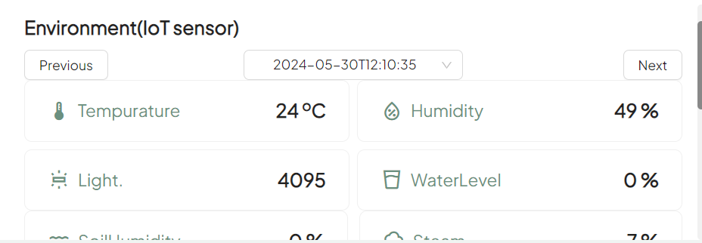
Modify Frontend
The previous frontend show fake data, but now the real data will show on webpage.
The frontend keep asking Mysql data from backend and it will show Frontend.
User can select date and time, and the all IoT data will show following date and time.

Slide 3
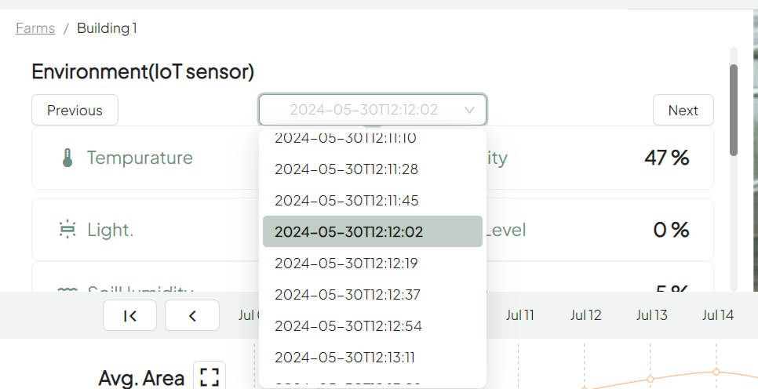
Update date and time
User can select date and time, and the IoT data will show with date and time.

Slide 4
Modify plot page
The previous plot page made by fake data which not used.
So we will change all variable and use real data through backend.

